Slide 1

Authentication in Angular
Mark A. Wilson Senior Developer MarkW@LogicalAdvantage.com
www.DeveloperInfra.com @DeveloperInfra

Slide 2

Mark A. Wilson
www.developerinfra.com
@DeveloperInfra
Notes:
17 notable references in Wikipedia.

Slide 3


Logical Advantage
www.logicaladvantage.com
Notes:
Business cards up front.

Slide 4


JavaScript Walkthrough
DEMO

Slide 5
Modern Applications

Slide 6
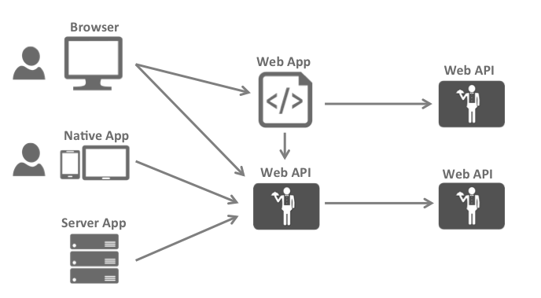
The Big Picture
https://identityserver.github.io/Documentation/docsv2/overview/bigPicture.html

Slide 7
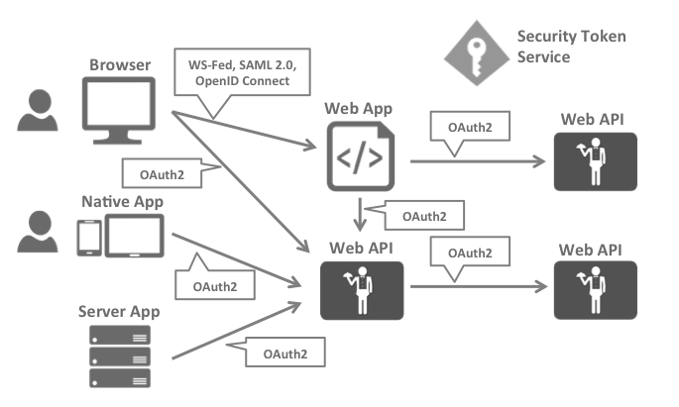
Security Protocols
https://identityserver.github.io/Documentation/docsv2/overview/bigPicture.html

Slide 8

Security Assertion Markup Language
Most popular & widely deployed
SAML 1.0 – November 2002
SAML 1.1 – September 2003
SAML 2.0 – March 2005
Browser single sign-on (SSO)
Problematic beyond intranet
XML-based
“Enterprisey” and “not trivial”
https://en.wikipedia.org/wiki/Security_Assertion_Markup_Language

Slide 9

OpenID Connect
Newest but generally considered to be the future
OpenID – May 2005
OpenID 2.0 – December 2007
OIDC [3.0] – February 2014
Designed to be more usable by native and mobile applications
RESTful HTTP API using JSON
Authentication layer on top of the OAuth 2.0 authorization framework
Uses the JSON Web Token (JWT) and JSON Object Signing and Encryption (JOSE) specs
https://en.wikipedia.org/wiki/OpenID

Slide 10
OpenID Connect

Slide 11
OpenID Connect
“OpenID Connect 1.0 is a simple identity layer on top of the OAuth 2.0 protocol.”
Defines identity tokens
Defines standard token type
Defines standard cryptography
Defines validation procedures
Defines flows for browser, native, and server-based apps
Combines authentication with short/long-lived delegated API access
http://openid.net/connect/

Slide 12
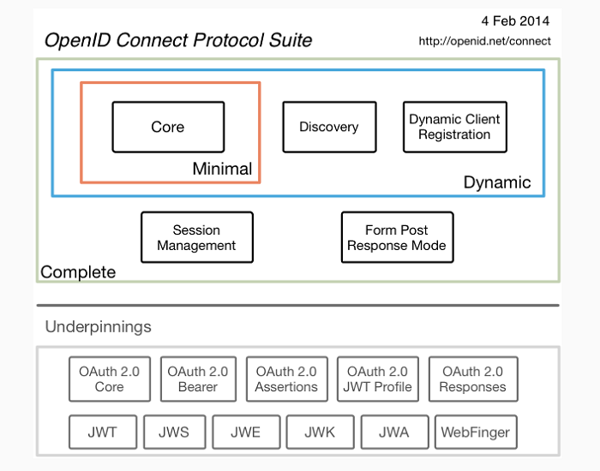
OpenID Connect
http://openid.net/connect/

Slide 13



Endpoints
Authorize Endpoint
Token Endpoint
UserInfo Endpoint

Slide 14

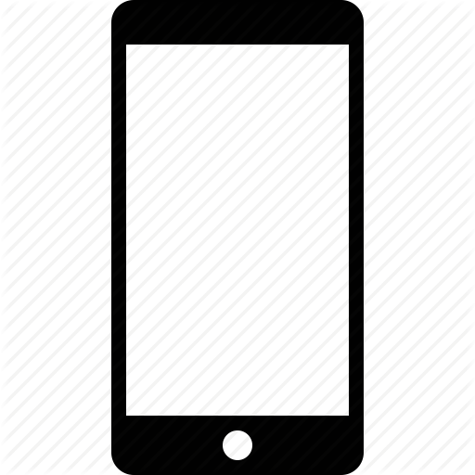

Flows
Client Credentials Flow
(Server-to-Server/IoT)
Implicit Flow
(Browser-based)
Hybrid Flow
(Native/Mobile)

Slide 15
Implicit Flow
GET /authorize
?client_id=app1
&redirect_uri=https://app.com/cb
&response_type=id_token
&response_mode=form_post
&nonce=a1b…x9z
&scope=openid email api1

Slide 16
Implicit Flow Response
POST /callback <form> <input type=“hidden” name=“id_token” value=“a1c…x9z” /> <input type=“hidden” name=“access_token” value=“z9x…c1a” /> </form>

Slide 17
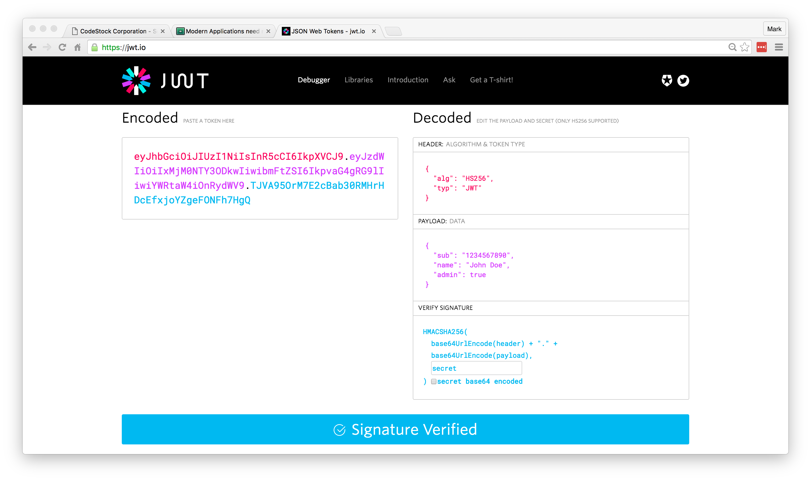
Identity Token
https://jwt.io/

Slide 18
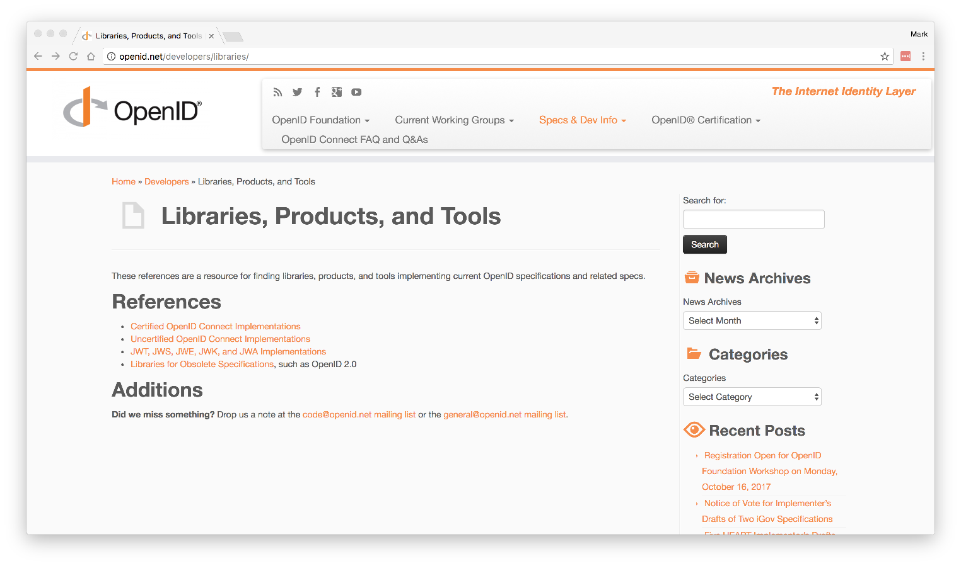
Libraries, Products, and Tools
http://openid.net/developers/libraries/

Slide 19
IdentityServer + oidc-client

Slide 20
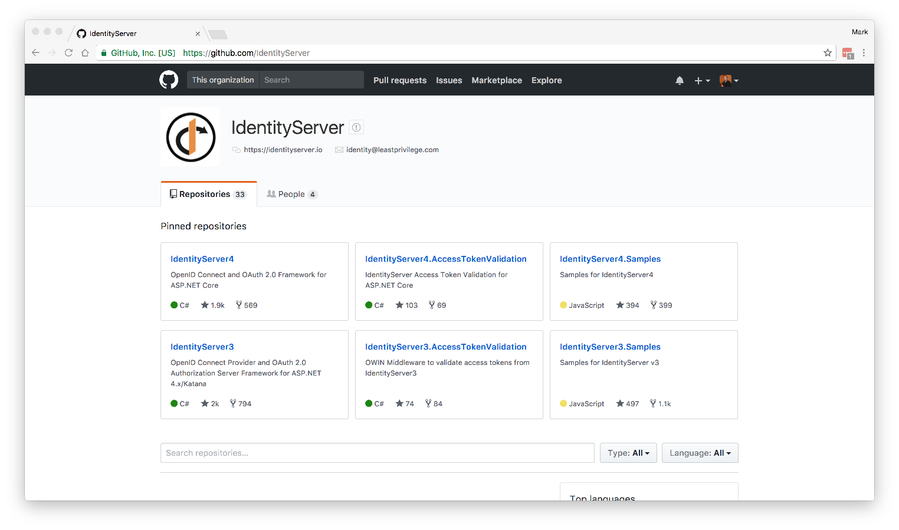
IdentityServer
https://github.com/IdentityServer

Slide 21
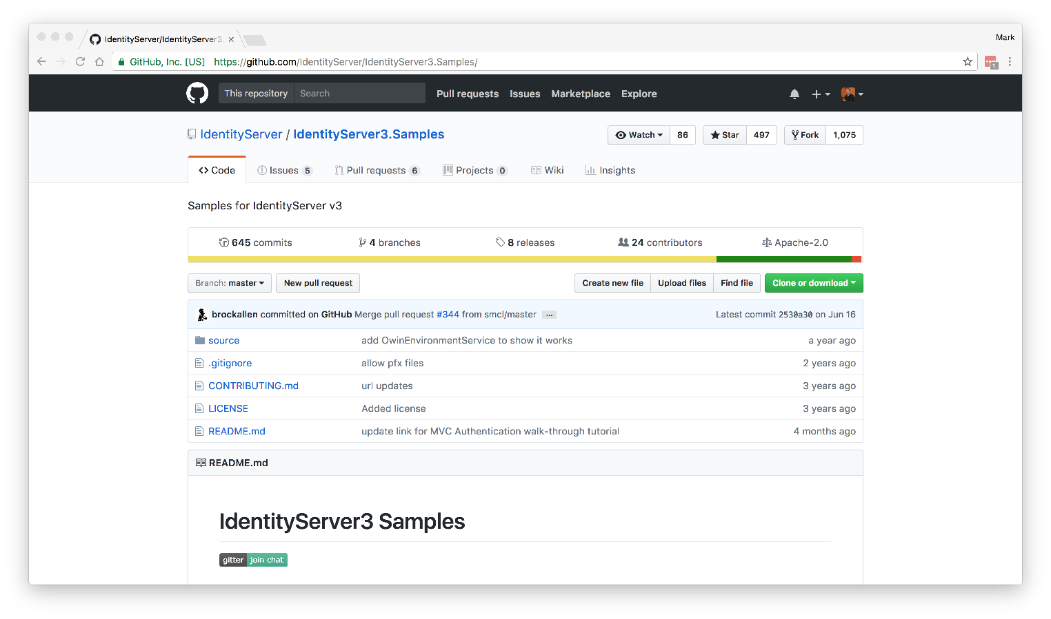
Samples
https://github.com/IdentityServer/IdentityServer3.Samples/

Slide 22
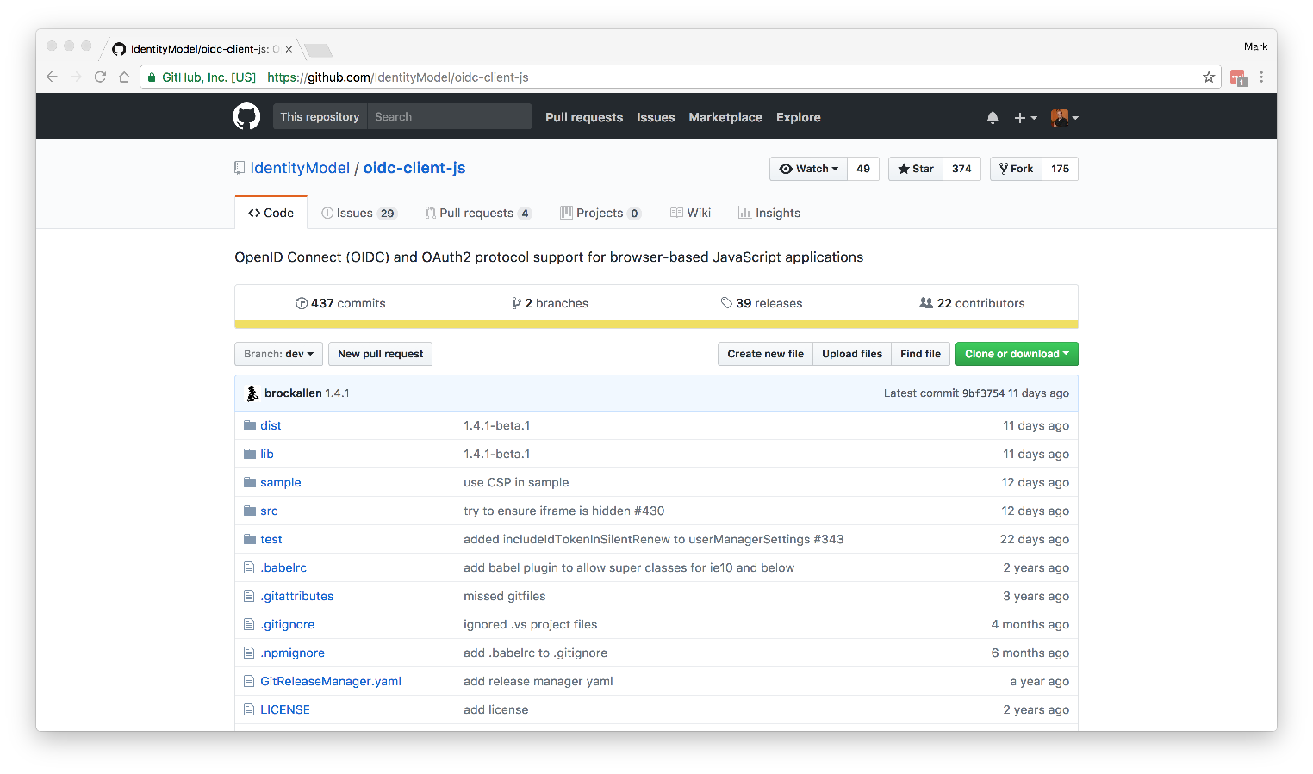
oidc-client
https://github.com/IdentityModel/oidc-client-js

Slide 23
Authentication in Angular
DEMO

Slide 24
Resources
OpenID Connect: http://openid.net/connect/
OpenID Connect Libraries: http://openid.net/developers/libraries/
IdentityServer: https://github.com/IdentityServer
IdentityServer Samples: https://github.com/IdentityServer/IdentityServer3.Samples/
OAuth for ASP.NET: https://github.com/matthewdunsdon/oauthforaspnet
JSON Web Tokens: https://jwt.io/
Notes:
HTTPS: Use it!
Forms Auth: Happy path, easiest to setup. Transmits in clear text.
3rd-Party Logins: All implemented differently. Takes time.
Custom Grant Type: Forms vs. 3rd-Party take separate paths.
Entity Framework: Everything uses it by default.
Production Ready: Maybe not public-facing. Very little validation/checking.

Slide 25
Authentication in Angular
Mark A. Wilson Senior Developer MarkW@LogicalAdvantage.com
www.DeveloperInfra.com @DeveloperInfra

